Slide 1
Deadlock & Prevention Technique
TEAM 8
T.SRI RAM – 22H51A73C1
T.PREETHAM REDDY-22H51A73C2
V.KARTHIK – 22H51A73C3

Slide 2
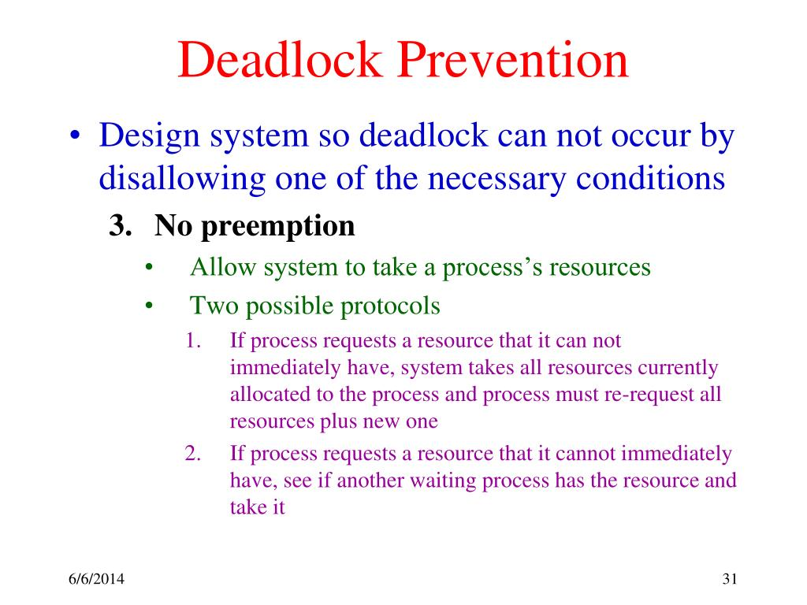
Introduction to Deadlock & Prevention Technique
Deadlock refers to a situation in which two or more processes are unable to proceed because each is waiting for the other to release a resource.
It is a critical issue in operating systems that can lead to system crashes and performance degradation.
Deadlock prevention techniques aim to identify and eliminate the conditions that lead to deadlocks.

Slide 3
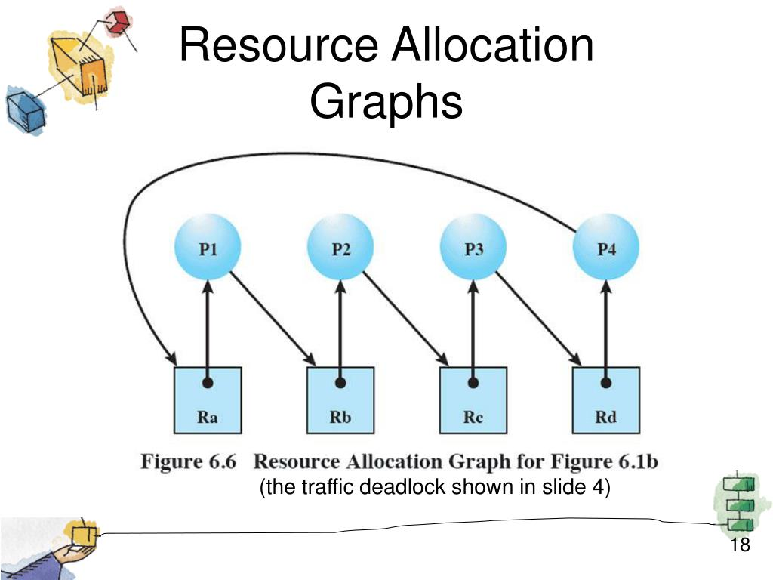
Resource Allocation Graph
The resource allocation graph is a graphical representation used to analyze deadlock situations.
It consists of processes represented by circles and resources represented by rectangles.
Directed edges indicate the request and allocation of resources between processes and resources, respectively.

Slide 4
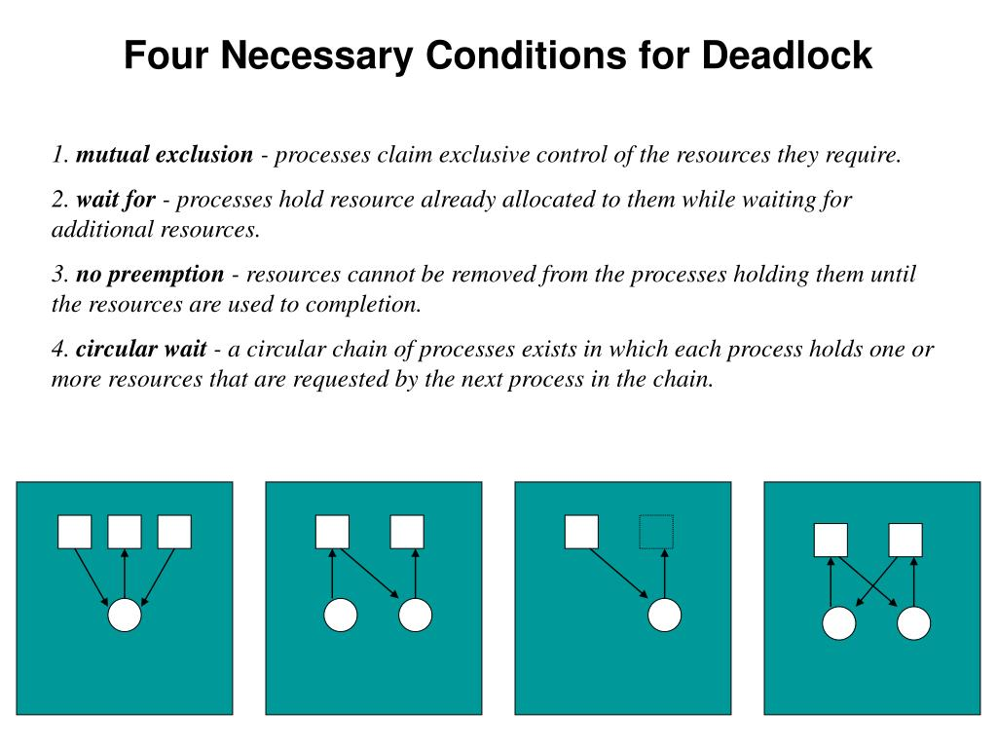
Necessary Conditions for Deadlock
Deadlocks occur when four necessary conditions are simultaneously present: mutual exclusion, hold and wait, no preemption, and circular wait.
Mutual exclusion refers to the condition where a resource can only be used by one process at a time.
Hold and wait implies that a process holding a resource can request additional resources while waiting for its current request to be fulfilled.

Slide 5
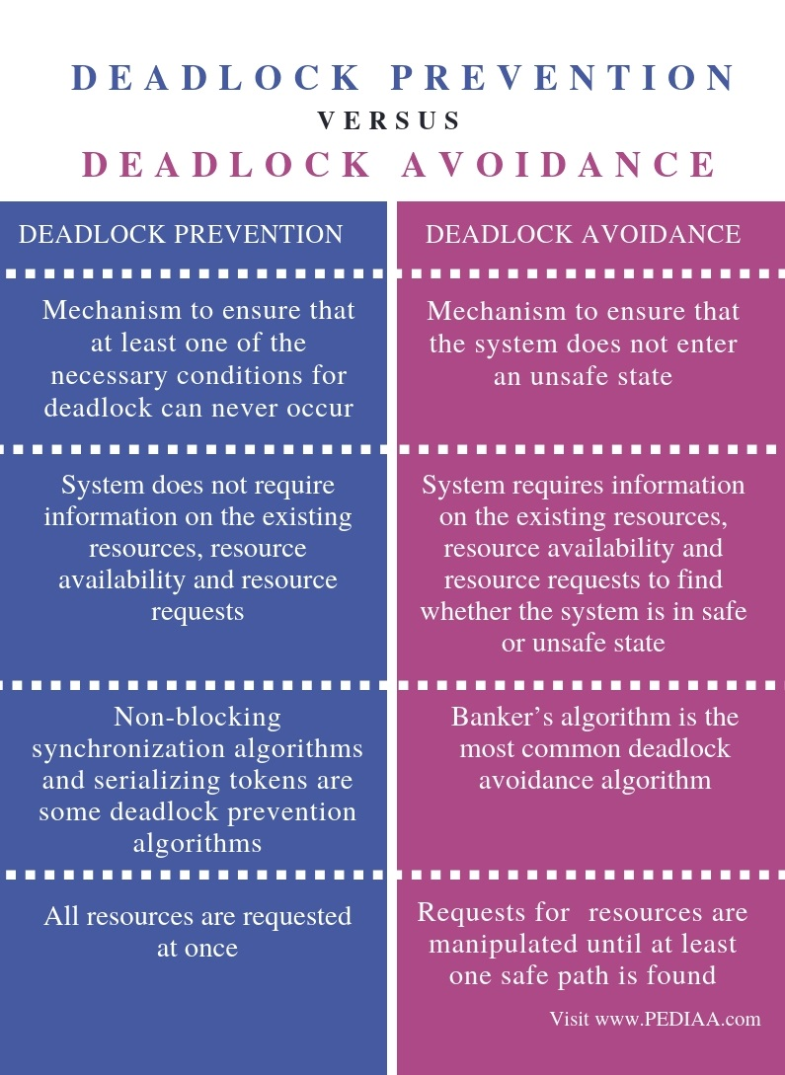
Deadlock Prevention Techniques
Deadlock prevention aims to break one or more of the necessary conditions to avoid deadlock occurrence.
One technique is to eliminate mutual exclusion by allowing multiple processes to access a resource simultaneously.
Another technique is to employ preemption, where resources can be taken away from one process and allocated to another if necessary.

Slide 6
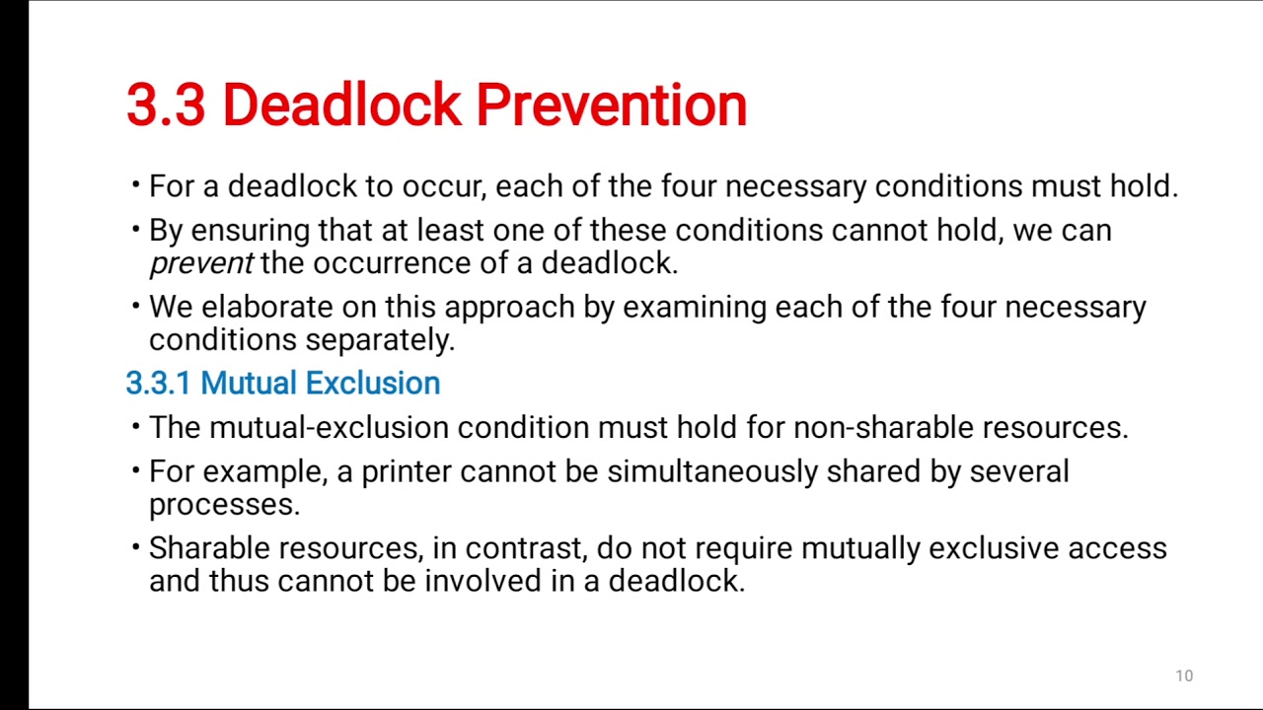
Deadlock Prevention Techniques (contd.)
Deadlock prevention can also be achieved by requiring processes to request all their required resources upfront, eliminating the hold and wait condition.
Additionally, circular wait can be prevented by imposing a total ordering of resources and requiring processes to request resources in a defined order.
Your third bullet

Slide 7
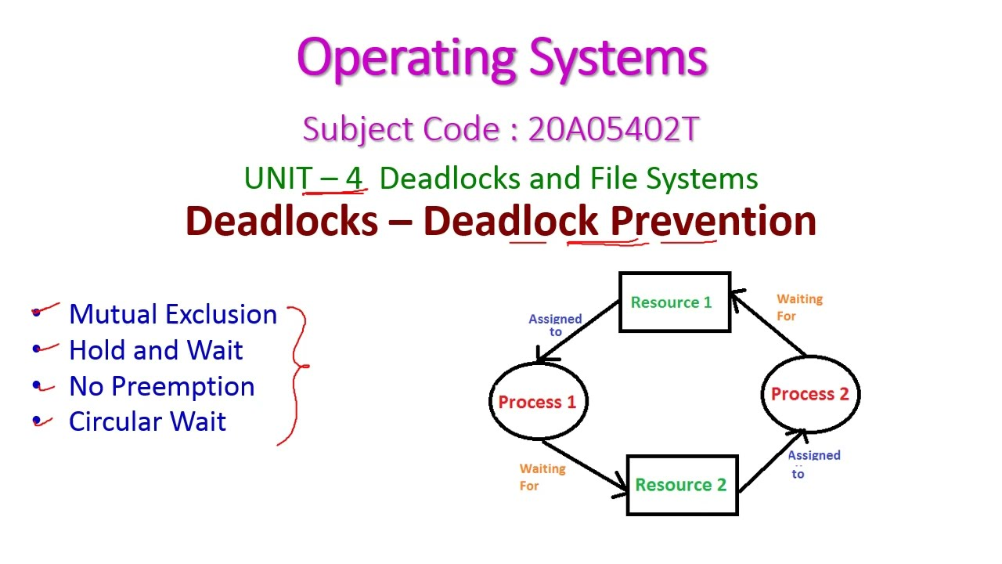
Advantages of Deadlock Prevention
Deadlock prevention techniques ensure that deadlocks do not occur in the system.
System stability and reliability are improved as deadlocks can lead to system crashes and freezes.
Prevention techniques allow for efficient resource utilization and minimize performance degradation.

Slide 8
Limitations of Deadlock Prevention
Deadlock prevention techniques may increase the overhead of resource management and require additional system resources.
The prevention techniques may also introduce complexities in the system design and implementation.
It is essential to carefully analyze the system requirements and constraints before selecting and implementing prevention techniques.

Slide 9
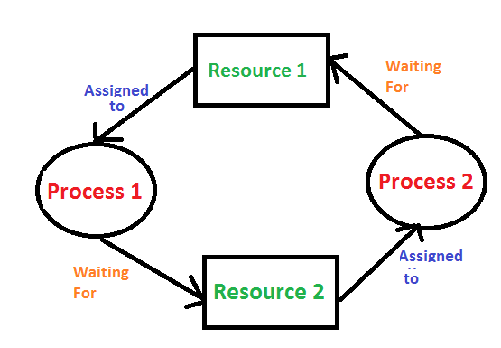
Conclusion
Deadlock prevention techniques play a crucial role in ensuring the stability and reliability of operating systems.
By breaking the necessary conditions for deadlock occurrence, these techniques help in efficient resource utilization.
It is important to carefully consider the advantages and limitations of prevention techniques when designing and implementing operating systems.

Slide 10
THANK YOU ☺

